Slide 1
Transfer-Based Black-Box Attack (Experiments)
Kim Seung Hwan (overnap@khu.ac.kr)

Slide 2
Datasets
MNIST
Imagenette
a subset of 10 easily classified classes from Imagenet
tench, English springer, cassette player, chain saw, church, French horn, garbage truck, gas pump, golf ball, parachute

Slide 3
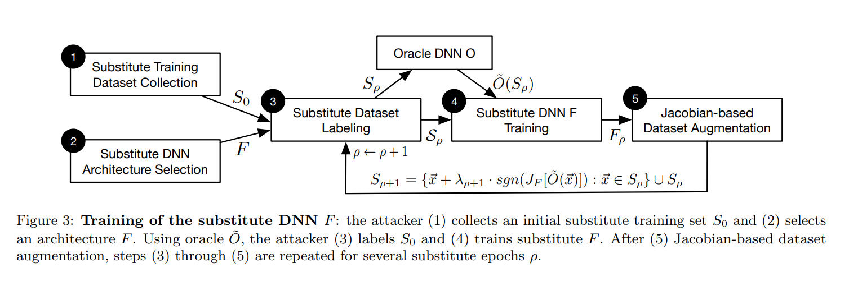
Black Box Attack Process (Recall)

Slide 4
Models & Learning Process
Oracle: ResNet50 (pretrained)
Substitute: ResNet34 (from scratch)
Optimizer: Adam
Learning rate: 1e-3 for MNIST, 1e-4 for Imagenette
Batch Size: 2048 for MNIST, 256 for Imagenette

Slide 5
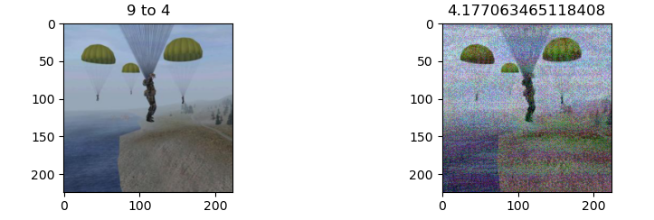
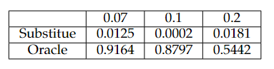
FGSM Parameter
The performance is poor if the FGSM parameter is small
But the perturbation is easily perceived if it is large

Slide 6
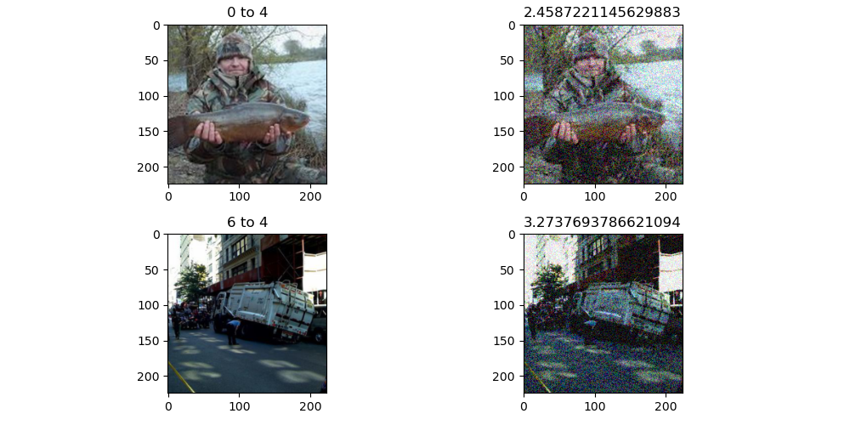
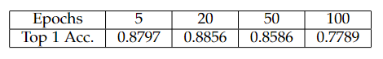
Training Epochs (Imagenette)
Number of training epochs per training iteration
i.e., Number of training epochs per augmentation

Slide 7
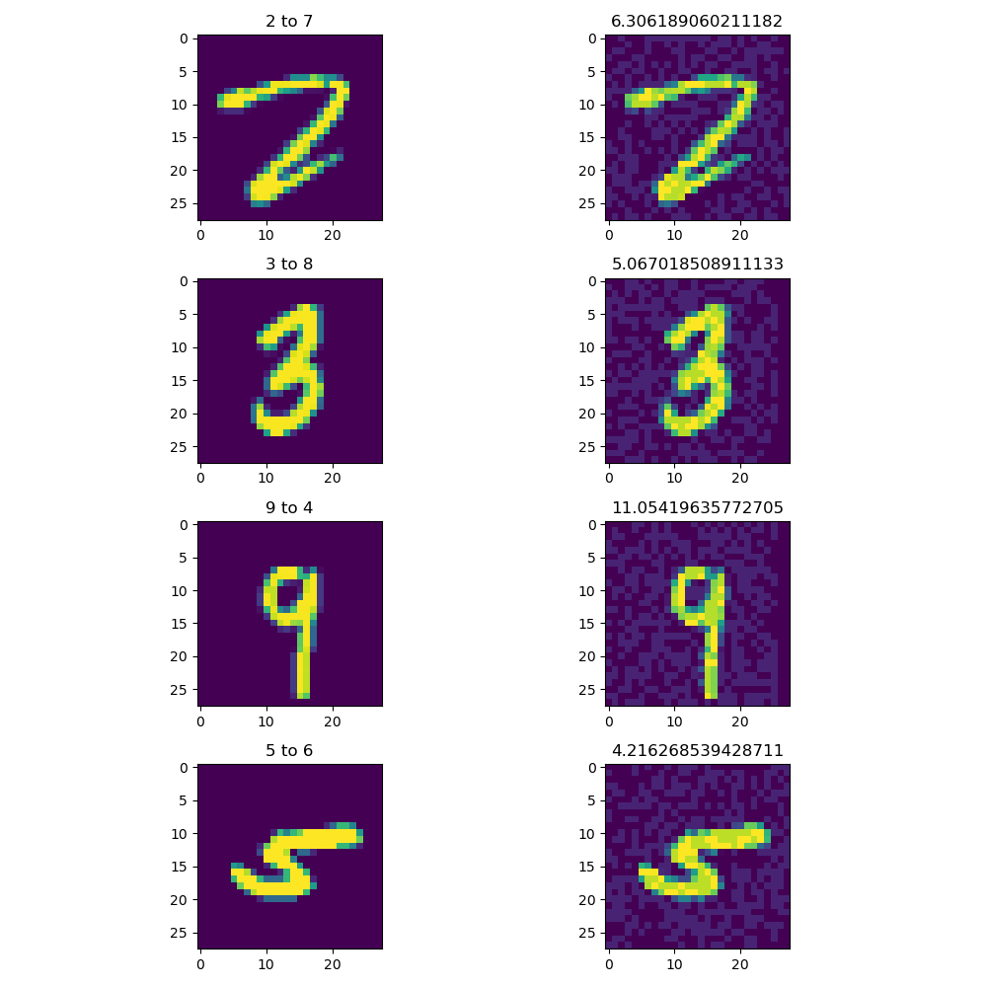
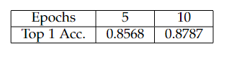
Training Epochs (MNIST)
No improvement in MNIST as mentioned in the paper

Slide 8
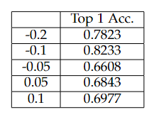
Jacobian Parameter (MNIST)
Got the best result with neg. parameter
However neg. parameter with large absolute produced very bad result

Slide 9
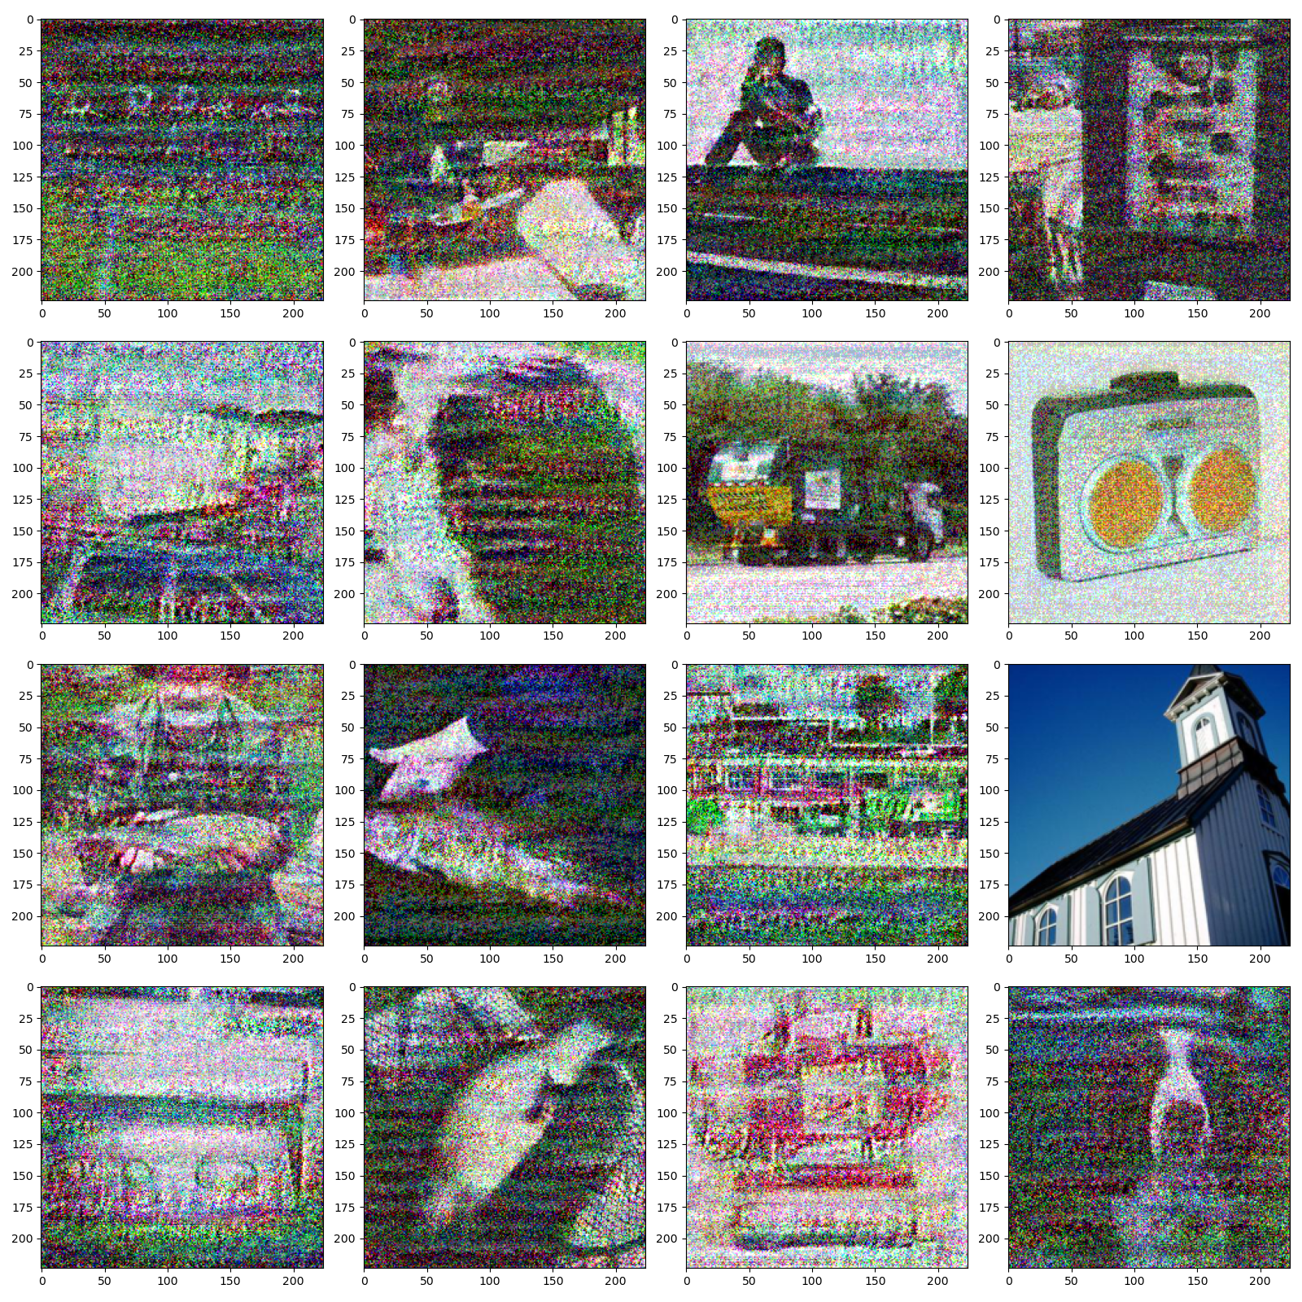
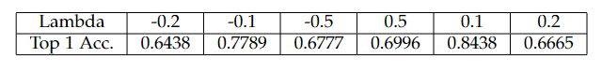
Jacobian Parameter (Imagenette)
It does not seem to matter

Slide 10
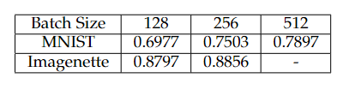
Initial Set Size
Having more initial images does not affect performance
Rather it tends to slightly decrease performance (Why?)

Slide 11
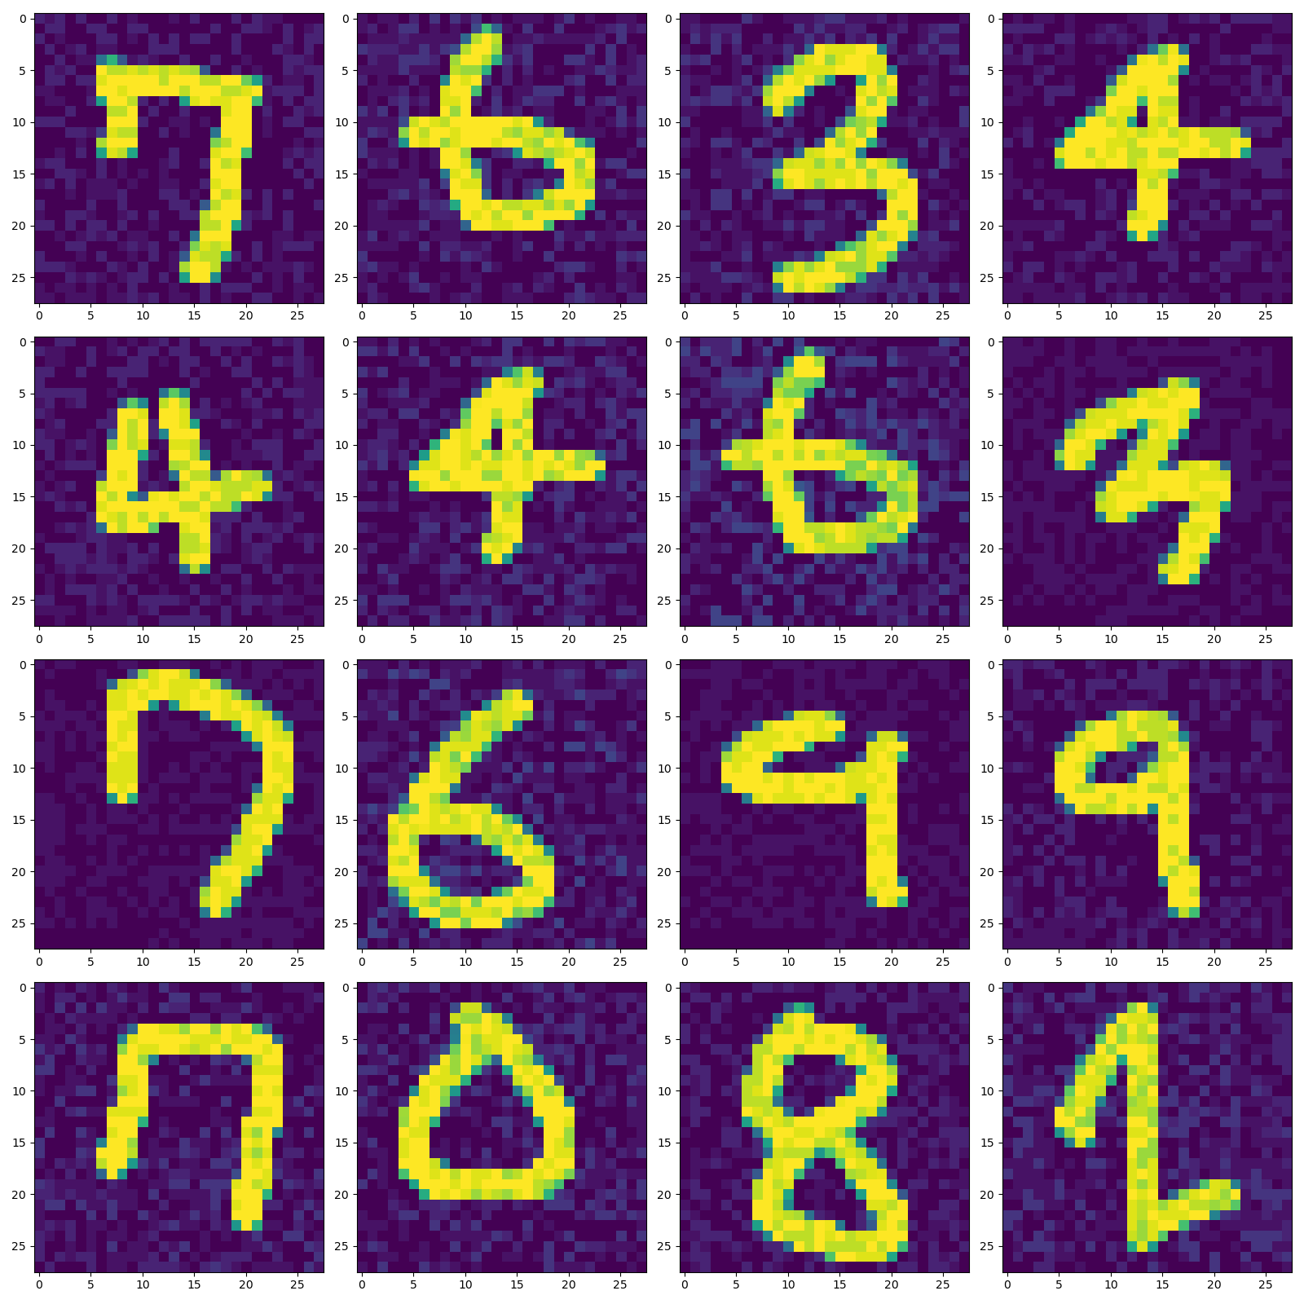
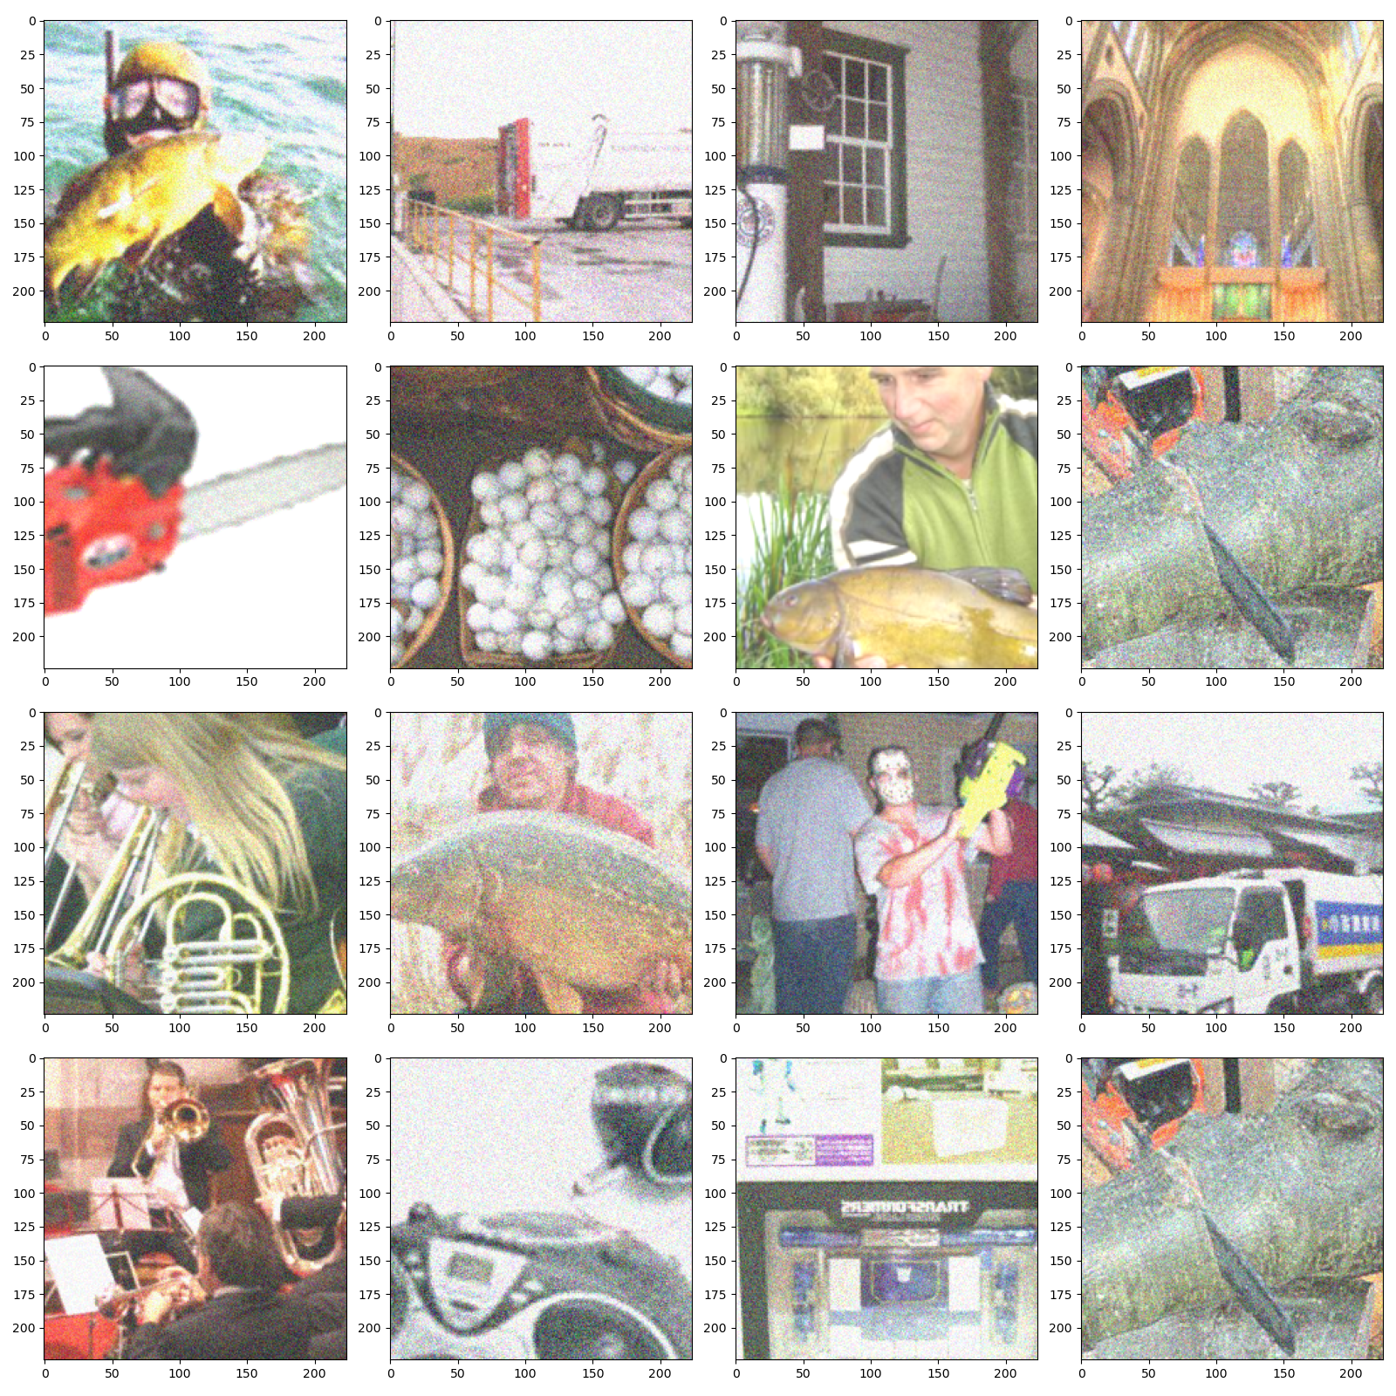
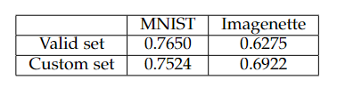
Initial Set From Another Dist.
64 handmade 0..9 digits images
128 biased images sampled from valid set;
Applied random crop and brightness bias

Slide 12
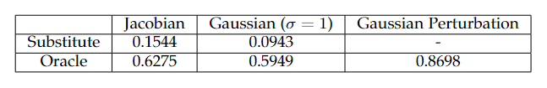
Gaussian Noise
Augmentation with Gaussian noise instead of Jacobian
Shocking result; contrary to what paper said

Slide 13
Thank you for listening
Kim Seung Hwan (overnap@khu.ac.kr)

